Slide 1
Algorithms

Slide 2
Informally Definition
An algorithm is any well-defined computational procedure that takes some values or set of values as input and produces some values or set of values as output

Slide 3
Formal Definition
As a sequence of computational steps that transforms the input into output

Slide 4
Algorithms
Properties of algorithms:
Input from a specified set,
Output from a specified set (solution),
Definiteness of every step in the computation,
Correctness of output for every possible input,
Finiteness of the number of calculation steps,
Effectiveness of each calculation step and
Generality for a class of problems.

Slide 5
?
Suppose computers were infinitely fast and computer memory are free
Is there any reason to study algorithm ?
Yes
Demonstrate that solution methods terminates and does so with correct answer.

Slide 6
If computers were infinitely fast, any correct method for solving a problem would do.
You would probably want your implementation to be within the bounds of good software engineering practice

Slide 7
In reality
Computers may be fast, but they are not infinitely fast and
Memory may be cheap but it is not free
Computing time is therefore a bounded resource and so is the space in memory

Slide 8
Complexity
In general, we are not so much interested in the time and space complexity for small inputs.

Slide 9
Complexity
For example, let us assume two algorithms A and B that solve the same class of problems.
The time complexity of A is 5000n, the one for B is ⎡1.1^{n}⎤ for an input with n elements.
For n = 10, A requires 50,000 steps, but B only 3, so B seems to be superior to A.
For n = 1000, however, A requires 50,00,000 steps, while B requires 2.5x10⁴¹ steps.

Slide 10
Complexity
Comparison: time complexity of algorithms A and B
Input Size
Algorithm A
Algorithm B
n
5,000n
⬆1.1^{n}
10
50,000
3
100
5,00,000
13,781
1,000
50,00,000
2.5x10⁴¹
1,000,000
5x10⁹
4.8x10⁴¹³⁹²

Slide 11
Complexity
This means that algorithm B cannot be used for large inputs, while algorithm A is still feasible.
So what is important is the growth of the complexity functions.
The growth of time and space complexity with increasing input size n is a suitable measure for the comparison of algorithms.

Slide 12
Growth Function
The order of growth / rate of growth of the running time of an algorithm gives a simple characterization of the algorithm efficiency and allow us to compare the relative performance of alternative algorithm

Slide 13
Asymptotic Efficiency Algorithm
When the input size is large enough so that the rate of growth / order of growth of the running time is relevant
That is we are concerned with how the running time of an algorithm increases with the size of the input in the limit, as the size of the input increases without bound

Slide 14
Asymptotic Efficiency Algorithm
Usually, an algorithm that is asymptotically more efficient will be the best choice for all but very small inputs.

Slide 15
Asymptotic Notation
The notations we use to describe the asymptotic running time of an algorithm are defined in terms of functions whose domains are the set of natural numbers N = {0, 1, 2,…. }

Slide 16
Asymptotic Notation
Asymptotic notations are convenient for describing the worst-case running time function T(n), which is defined only on integer input size.

Slide 17
Asymptotic Notation
Let n be a non-negative integer representing the size of the input to an algorithm

Slide 18
Asymptotic Notation
Let f(n) and g(n) be two positive functions, representing the number of basic calculations (operations, instructions) that an algorithm takes (or the number of memory words an algorithm needs).

Slide 19
Asymptotic Notation
Θ - Big Theta
O – Big O
Ω - Big Omega
o – Small o
ω - Small Omega

Slide 20
O-Notation
For a given function g(n)
O(g(n)) = {f(n) : there exist positive constants c and n₀ such that 0 ≤ f(n) ≤ c g(n) for all n ≥ n₀ }
Intuitively: Set of all functions whose rate of growth is the same as or lower than that of
c. g(n)

Slide 21
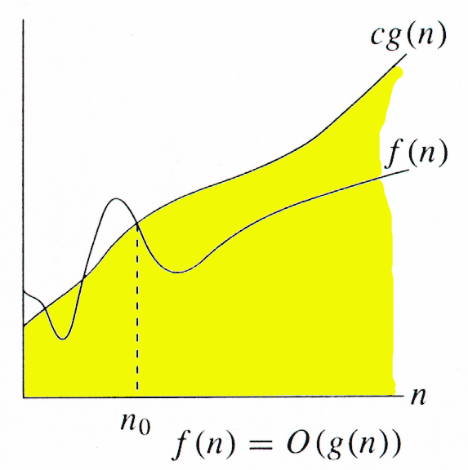
O-Notation
g(n) is an asymptotic upper bound for f(n).
f(n)  O(g(n)) ⇒ f(n) = O(g(n)).

Slide 22
Example
O(g(n)) = {f(n) : there exist positive constants c and n₀ such that 0 ≤ f(n) ≤ c g(n) for all n ≥ n₀ }
f(n) = 5n+2
0 ≤ 5n+2 ≤ 6n
n=0 → 0≤2≤0 (no)
n=1 → 0≤7≤6 (no)
n=2 → 0≤12≤12 (yes)
n=3 → 0≤17≤18 (yes)
So n₀=2, c=6, g(n)=n
⇒ f(n)= O(n)

Slide 23
Big-O Notation (Examples)
f(n) = 5n+2 = O(n) // g(n) = n
f(n)=n/2 –3 = O(n)
n²-n = O(n²) // g(n) = n²
n(n+1)/2 = O(n²)

Slide 24
Ω - Notation
For a given function g(n)
Ω(g(n)) = {f(n) : there exist positive constants c and n₀ such that 0 ≤ c g(n) ≤ f(n) for all
n ≥ n₀}
Intuitively: Set of all functions whose rate of growth is the same as or higher than that of c.g(n).

Slide 25
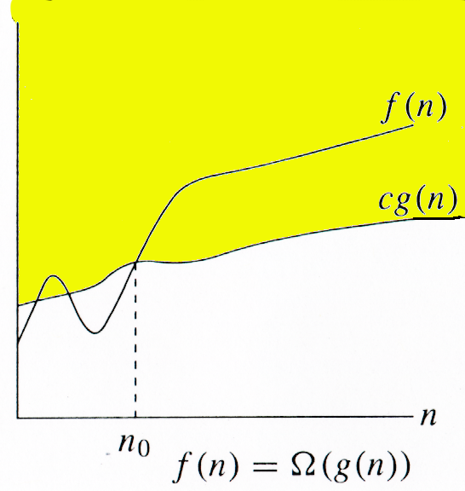
Ω - Notation
g(n) is an asymptotic lower bound for f(n).
f(n)  (g(n))  f(n) = (g(n)).

Slide 26
Example
Ω(g(n)) = {f(n) : there exist positive constants c and n₀ such that 0 ≤ c g(n) ≤ f(n) for all n ≥ n₀}
f(n) = 5n+2
0 ≤ 5n ≤ 5n+2
n=0 → 0≤0≤2 (yes)
n=1 → 0≤5≤7 (yes)
n=2 → 0≤10≤12 (yes)
So n₀=0, c=5, g(n)=n
⇒ f(n)= (n)

Slide 27
Θ - Notation
For a given function g(n), we denote by Θ(g(n)) the set of functions
Θ(g(n)) = {f(n) : there exist positive constants c₁ , c₂ , and n₀ such that 0 ≤ c₁ g(n) ≤ f(n) ≤ c₂ g(n) for all n ≥ n₀
f(n) ∈ Θ(g(n)) f(n) = Θ(g(n))

Slide 28
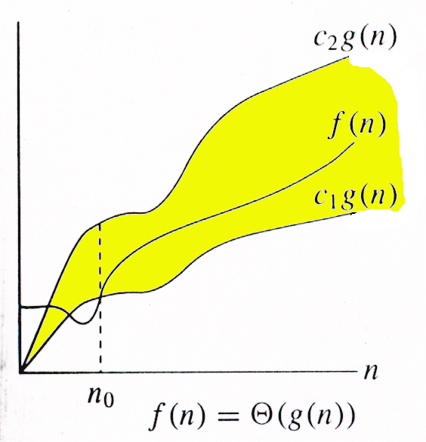
Θ - Notation
g(n) is an asymptotically tight bound for f(n).
f(n) and g(n) are nonnegative, for large n.

Slide 29
Example
Θ(g(n)) = {f(n) : ∃ positive constants c₁, c₂, and n₀, such that ∀n ≥ n₀, 0 ≤ c₁g(n) ≤ f(n) ≤ c₂g(n) }
5n+2 = Θ(n)
Determine the positive constant n₀, c₁, and c₂ such that the above conditions satisfies
5n ≤ 5n+2 ≤ 6n

Slide 30
Example Contd ...
5n ≤ 5n+2 is true for all n ≥ 0
5n+2 ≤ 6n is true for all n≥2
⇒ 5n ≤ 5n+2 ≤ 6n is true for all n≥2
c1=5, c2=6, g(n)=n
f(n)= Θ(g(n)) = Θ(n)

Slide 31
Relations Between Θ, O, Ω

Slide 32
Relations Between Θ, O, Ω
For any two function f(n) and g(n), we have f(n) = Θ(g(n)) if and only if f(n) = O(g(n)) and f(n) = Ω(g(n))
That is
Θ(g(n)) = O(g(n)) ∩ Ω(g(n))

Slide 33
The Growth of Functions
“Popular” functions g(n) are
n log n, 1, 2^{n}, n², n!, n, n³, log n
Listed from slowest to fastest growth:
1
log n
n
n log n
n²
n³
2^{n}
n!

Slide 34
Comparing Growth Rates
2^{n}
n²
n log₂ n
n
T(n)
log₂ n
Problem Size

Slide 35
Example: Find sum of array elements
Algorithm arraySum (A, n)
Input array A of n integers
Output Sum of elements of A # operations
sum ← 0 1
for i ← 0 to n − 1 do n+1
sum ← sum + A [i] n
return sum 1
Input size: n (number of array elements)
Total number of steps: 2n + 3 = f(n)

Slide 36
Example: Find max element of an array
Algorithm arrayMax(A, n)
Input array A of n integers
Output maximum element of A # operations
currentMax ← A[0] 1
for i ← 1 to n − 1 do n
if A [i] > currentMax then n -1
currentMax ← A [i] n -1
return currentMax 1
Input size: n (number of array elements)
Total number of steps: 3n

